Slide 1
Introduction to Data Science
Semester Project
Team Members:
1.Rehan Vipin
2.Ritik Hariani
3.Romaanchan Skanda

Slide 2
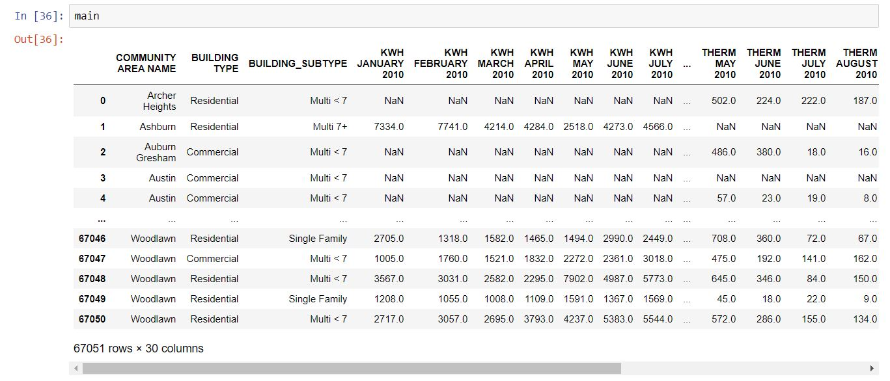
What is our Data Set?
Our data set is based on the energy consumption in the state of Chicago in the year 2010. It has the electricity and the thermal(CNG or Heat)energy consumption of every Month. This accounts for every residential, commercial and Industrial user.
Notes:
Nothing much in this. Inspiration for Dataset: Blizzard of 2011, Go through what it was, and the period.

Slide 3
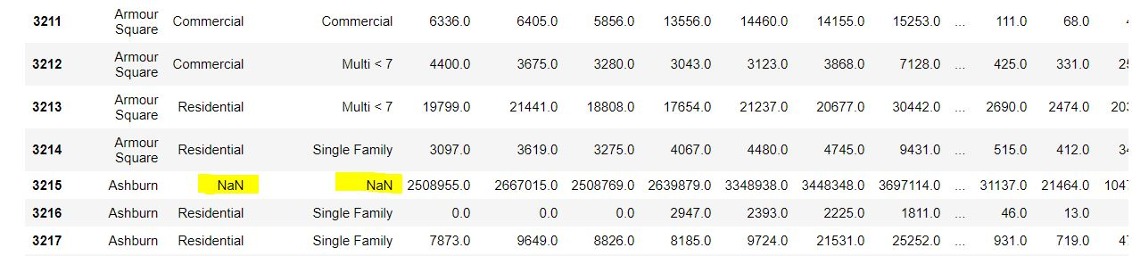
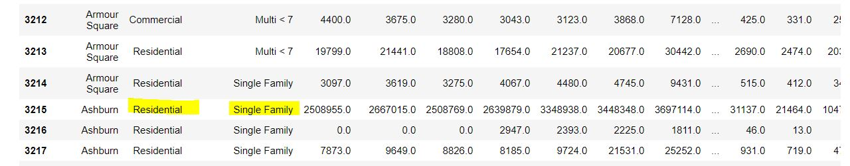
Cleaning the Data set
Categorical Data
The missing values in the categorical data have been filled with the values in the previous row.

Slide 4
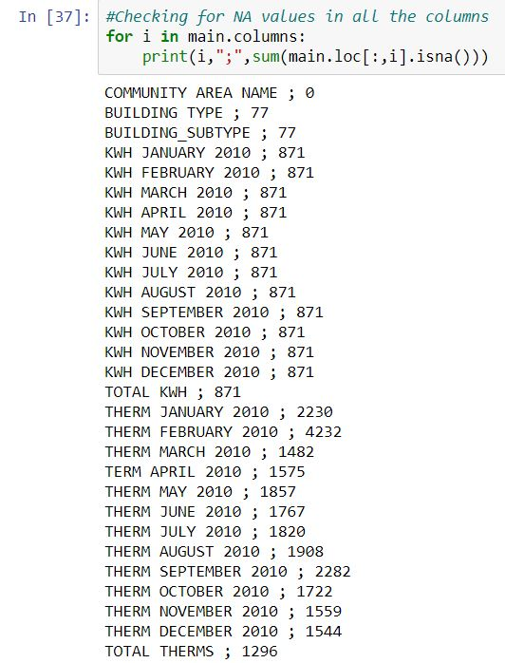
Cleaning the Data set
Filling the missing values(for Numerical)
The missing values have been filled with zeros. This is done because, if at all the values are missing it means there is
no usage of electricity or thermal.
Treatment of Outliers
The outliers in the electricity columns have been filled
with the average of that particular columns. While that
In the thermal section have been interpolated.
Notes:
I have checked the values(totals), missing values have to be set zero

Slide 5
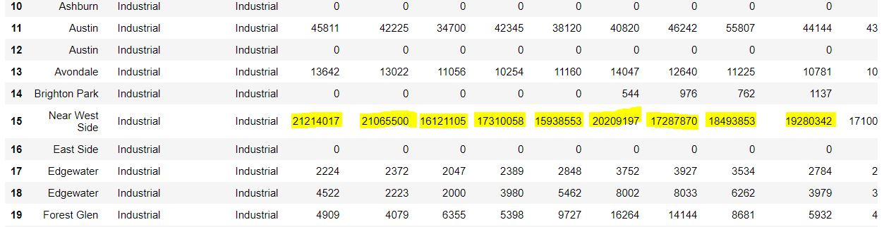
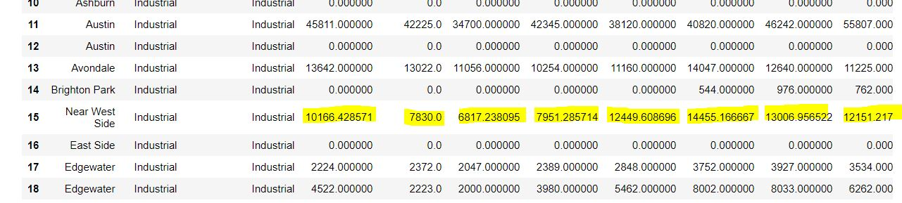
Examples of Cleaning(For Electricity)

Slide 6
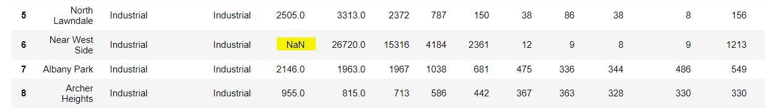
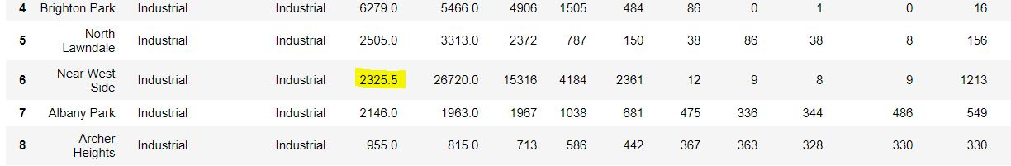
Examples of Cleaning(For Thermal)

Slide 7
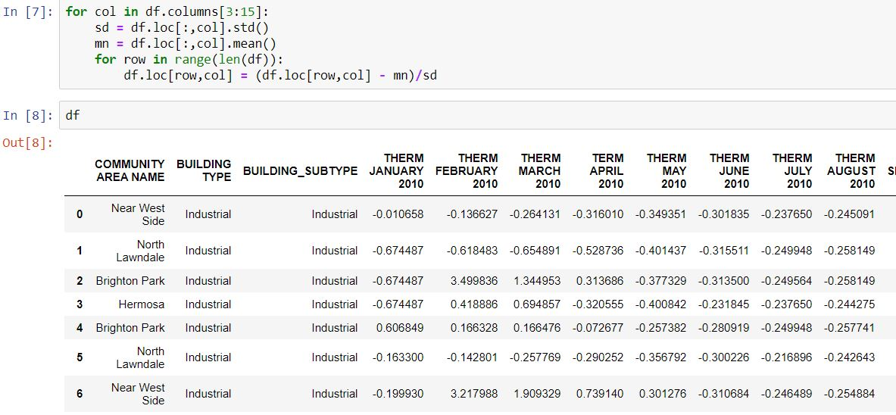
Normalization of Data
The data is standardized such that the mean of the column is 0 and the variance is 1. The mean and variance are only for those who have used the energy and not for everyone

Slide 8
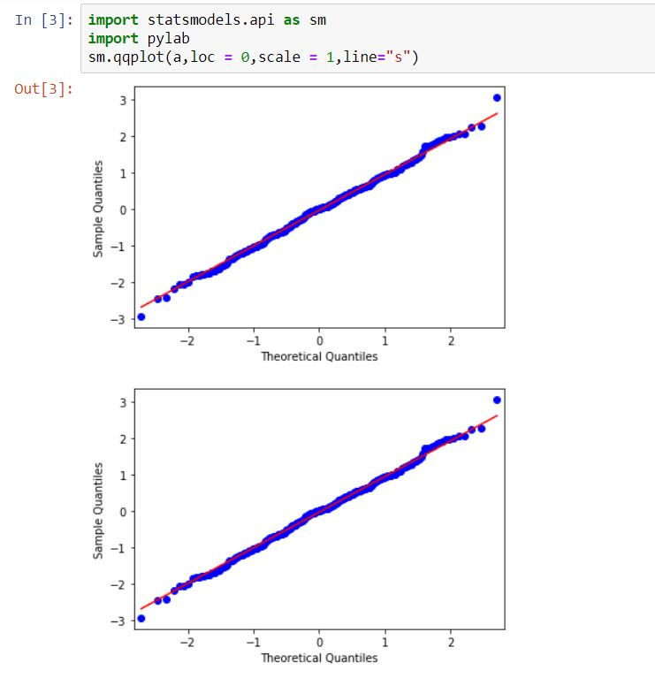
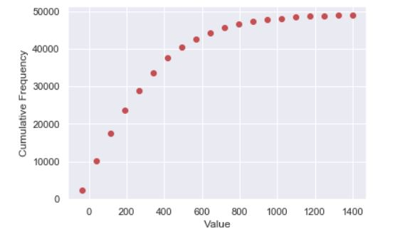
Proof that the data is normal
We can find out if the given data is approximately normal by plotting the quantile-quantile plot and the cumulative frequency plot

Slide 9
Why Normalization? How does it affect the dataset
Normalization helps in scaling the data. By doing this, we can comparing two separate columns. This can also be used for predictions

Slide 10
Visualizing the given data
Why Visualization?
Visualization of a given dataset helps in better understanding of the given data.
We are going to understand the total energy distribution of electricity by using the bar plot.
We can also use a pie chart to check for this.

Slide 11
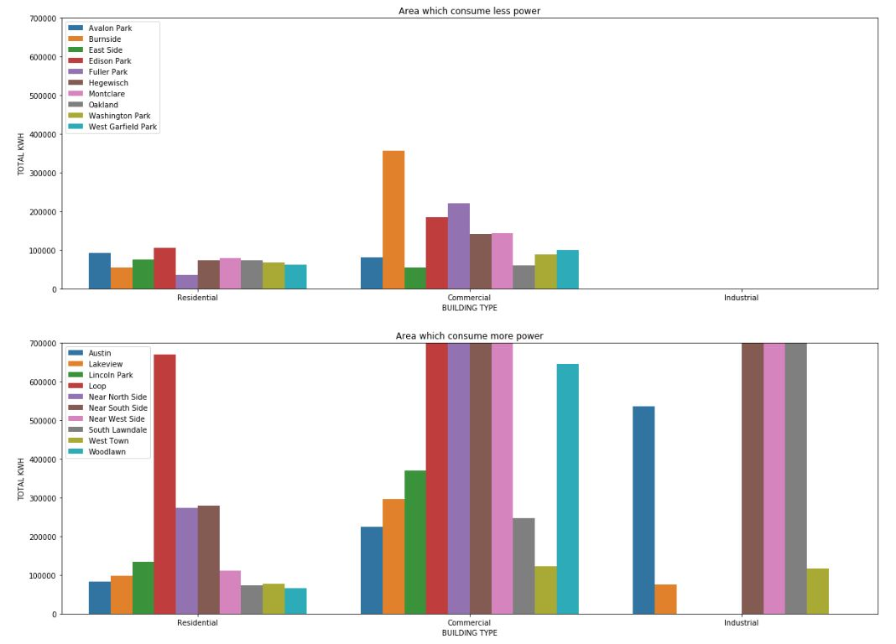

Slide 12
Inference
All the Industries in the state of Chicago are present in the cities which have a lot of energy consumption. This is because these cities are a bit more developed compared to the others. Hence they offer better infrastructure and environment which helps in better productivity.
Most of the energy consumption is in the Commercial sector keeping in account for the huge shopping complexes, Malls and manufacturing Depots.

Slide 13
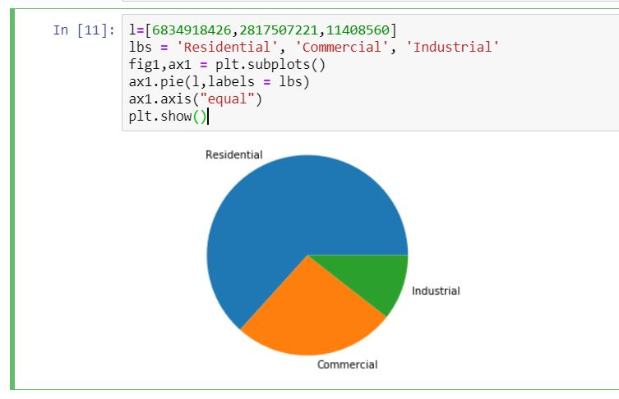
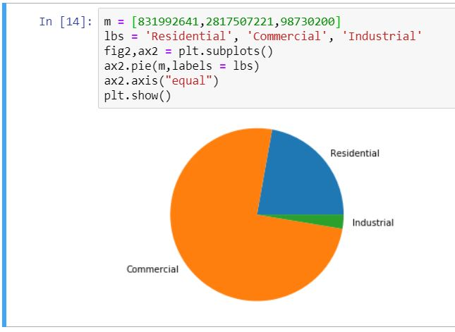
Visualisation
By plotting the pie chart we can see that Chicago is not a state which is more feasible for the deployment of Industries.
This might be due to the scarcity of resources and vast density of the state. Considering the high population of the state, there are more residential units which consume electricity.
We can also see that the most of the heat energy that is being used up is due to that of commercial and residential sector. Industries hardly use up any.
Notes:
The left one is for thermal , the right one is for electrical

Slide 14
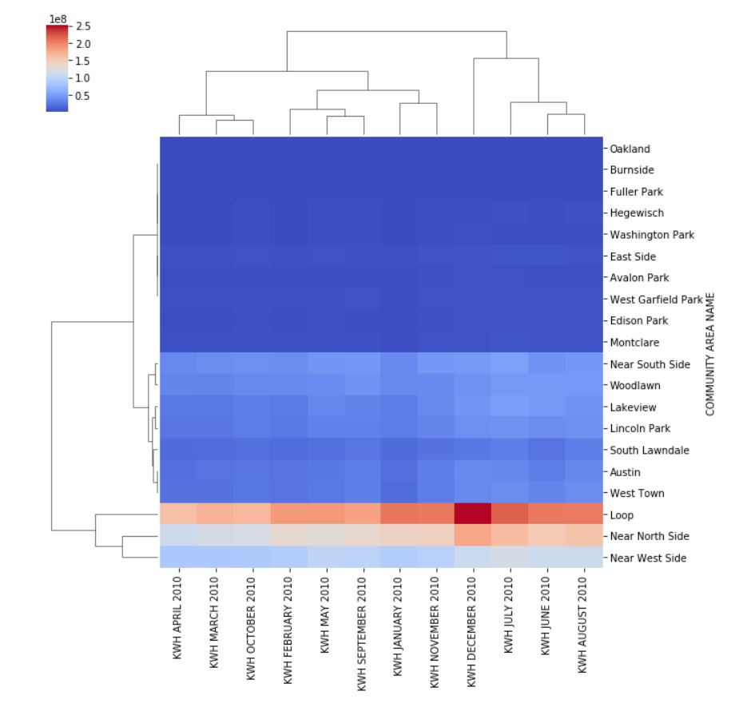
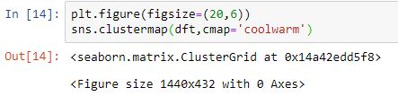
Visualisation
The total energy consumption in a household is
geography specific. So if a building is present in a
place like Oakland then the consumption is less. If
it is present in a place like west side its high.
This might be due to the denser population in these
cities and their geographical areas.
We can also see that the energy consumption in
one particular month is independent of the others.

Slide 15
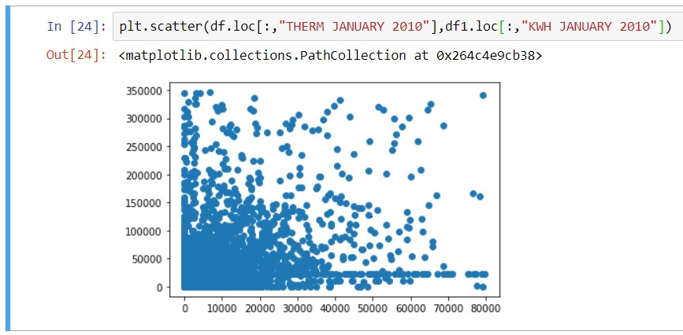
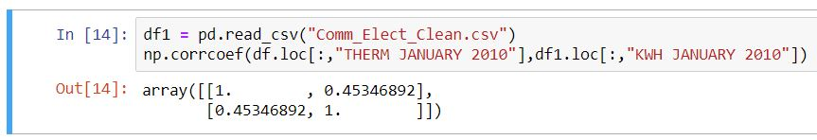
Checking for Correlation
As we know that the energy consumption
in one month adds to the total
consumption. Hence there is bound
to be a correlation between them.
We can also prove that the energy
consumption in every month is
independent

Slide 16
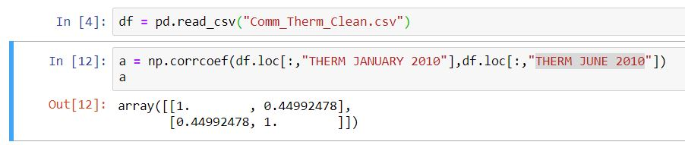
Checking for Correlation
The Electricity consumed in a particular month also depends weakly on the Thermal Energy consumed in that particular month. As in most of the houses people usually use Electricity .Only the houses which don’t have Electricity or stay in less developed areas consume more Heat Energy.
The energy consumption depends on the city or locality in which that particular household is present. The Community such as Oakland have relatively lesser Consumption than the places such as West Town

Slide 17
Hypothesis Testing
Let the Hypothesis be as follows
NULL Hypothesis H0 :
Mean for the thermal consumption in the month of
JUNE is same as that of SEPTEMBER for the commercial sector.
mA=mB
Alternate Hypothesis H1 :
Mean for the thermal consumption in the month of
JUNE is not same as that of SEPTEMBER for the commercial sector.
mA ! = mB

Slide 18
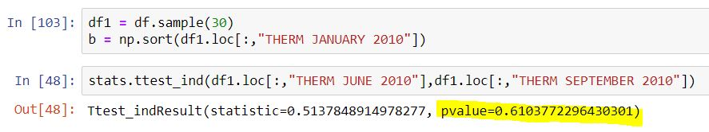
Proof for the Hypothesis Test
We will be using a t-test to check for the hypothesis. The ttest_ind() function is used to check if the two series that have been passed have the same sample mean. Its a two tailed test with a confidence

Slide 19
Result of the Hypothesis Test
Since the p-value of the test is greater than the alpha value(which is 0.05 considering the 95% significance level) , Hence, We fail to reject the NULL Hypothesis.
Therefore we can say that the sample mean for the thermal consumption in the month of JUNE is same as that of SEPTEMBER in the Commercial Sector.

Slide 20
Final Inference
Blizzard of 2011
Due to this sudden spike in the energy consumption, during the Blizzard the
electricity could not be delivered to every household resulting in mad
medical situations.
Sight of more Industries
During the year of 2010 more Industries came into the picture, which increased the total kWh usage of that particular city
Implementation of more renewable resources
By this the Chicago government spread the awareness for the usage of renewable energy to compensate for 2010

